Slide 1
End-to-end Tag-based Recommendation System
ETRS
An End-to-end Tag-based Recommendation System for Verbal Reasoning Questions

Slide 2
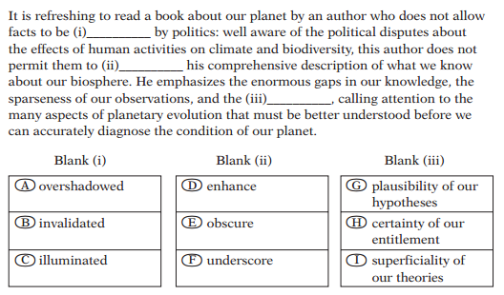
Text Completion Question

Slide 3
Verbal Reasoning
Understand the sentences
Find logic & keywords
Predict the blank words

Slide 4
Difficulty
Complicated Clauses
Unfamiliar Words
Duplicated Logic
Vague Reference
…

Slide 5
Question Tags
Based on logical keywords
Clauses
Adversative
Refer
…

Slide 6
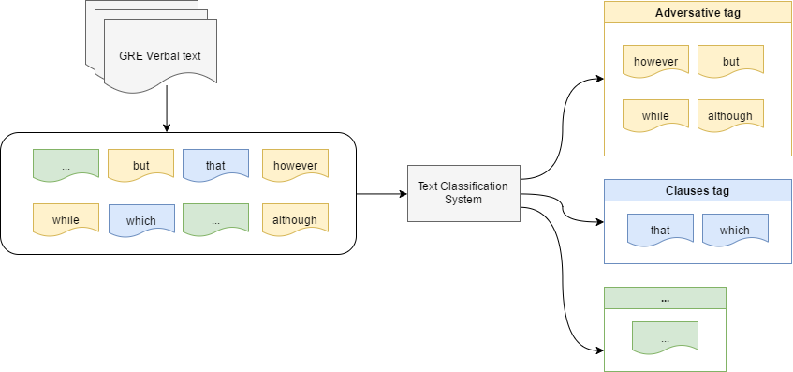
Auto-Tagging

Slide 7
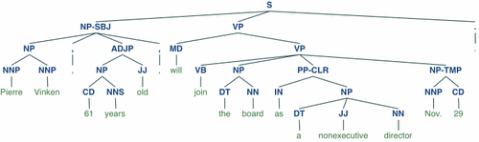
Nature Language Processing
Natural Language Toolkit (NLTK)

Slide 8
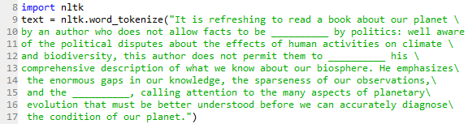
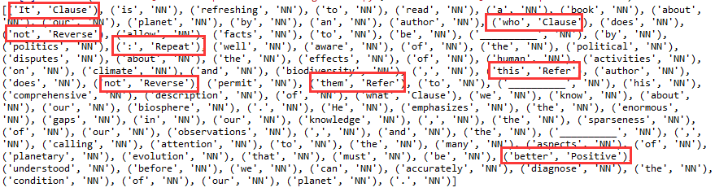
Text Tokenization

Slide 9
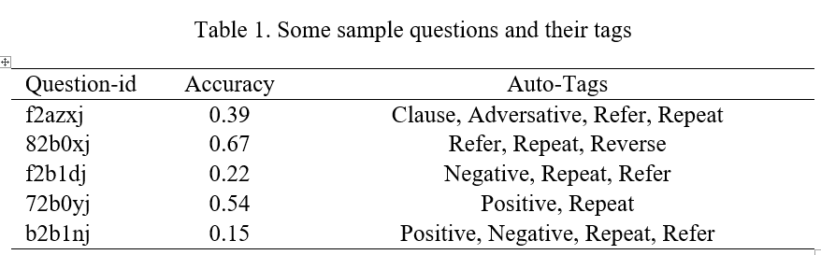
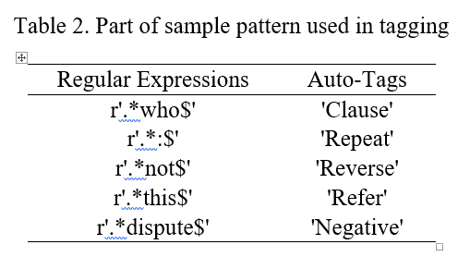
Auto-Tags

Slide 10
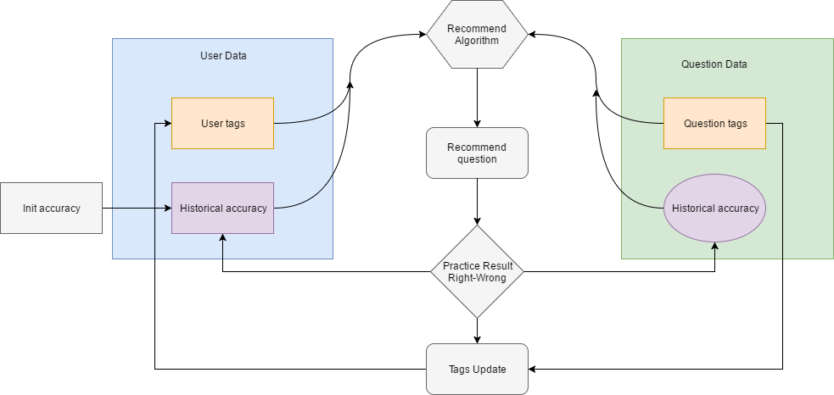
User tags

Slide 11

Cold-start Problem
New question
Auto-Tagging
New user
Accuracy Matching

Slide 12
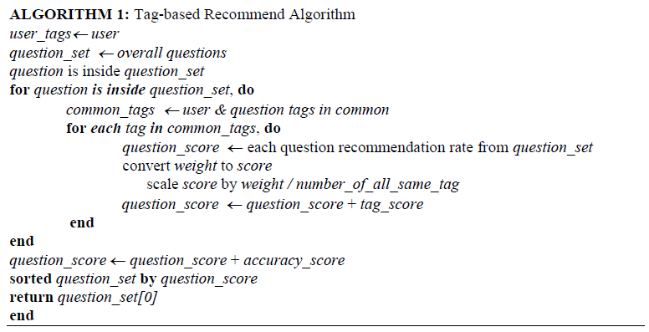
Tag-Based Recommend

Slide 13

Score Function
𝑆(q) means the evaluated score for each question in question set, 𝑅𝑚𝑎𝑡𝑐ℎ𝑖𝑛𝑔 is what we got from the accuracy matching process, 𝑊𝑡𝑎𝑔 represent the weight of each tag in common tags and 𝑁𝑎𝑙𝑙 𝑠𝑎𝑚𝑒 𝑡𝑎𝑔 means the number of all same name tags.

Slide 14

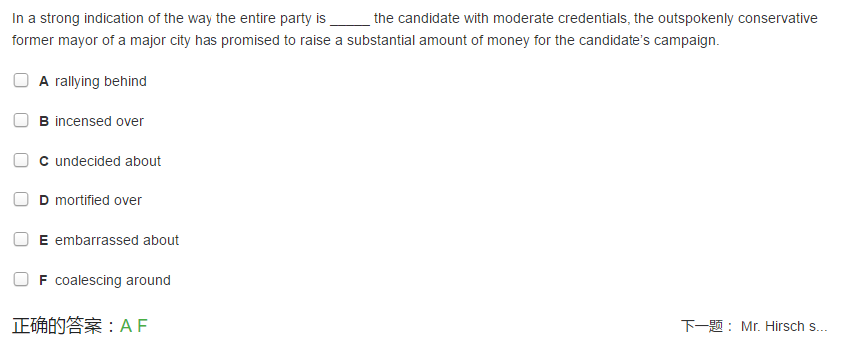
Process

Slide 15
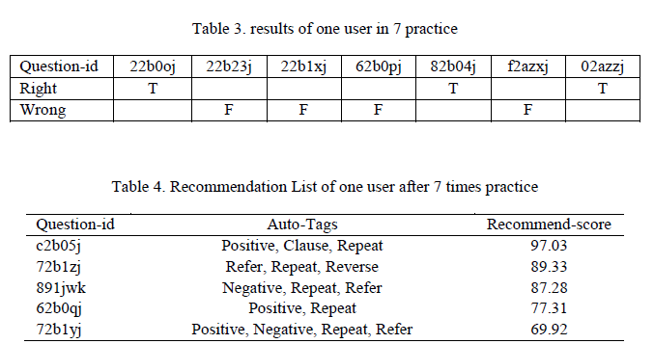
Results

Slide 16
Thank You & Any Question?
Zhixiong Yue, SUSTech, Student
https://oliver-q.github.io/
https://github.com/Oliver-Q/ETRS-for-Verbal-Reasoning-Questions

